Slide 1
Step Into Java:
2 Dimensional
Arrays!
Mr. Neat
Java

Slide 2
Pix – Revisit
Let’s return to the first pix lab and explore
our photos
Load a pix, scale it to 10% of original size,
then zoom 500%
What do you see?

Slide 3
Pix – Revisit
Can represent the pix as a
tiled floor
Sort of like a Seurat painting…

Slide 4
Pix – 2 Dimensional Array
Data structure is an array
of arrays
0
1
2
3
0
0
0
0
0
1
2
3
1
1
1
1
0
2
2
2
2
0
1
2
3
1
3
3
3
3
row major
order
column major
order

Slide 5
Pix – 2 Dimensional Array
Data structure is an array
of arrays
We use
this!
0
1
2
3
0
0
0
0
0
1
2
3
0
1
1
1
1
0
1
2
3
2
2
2
2
1
3
3
3
3
row major
order
column major
order

Slide 6
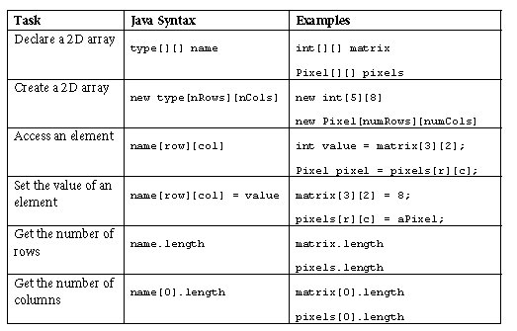
Pix – 2 Dimensional Arrays –common Java syntax

Slide 7
Pix – 2 Dimensional Arrays –Example
Let’s add up the elements in
a 2D array:
1 array of columns (columns)
0
1
2
3
0
another array of columns
(columns)
0
1
2
3
1
array of column arrays (rows)

Slide 8
Pix – 2 Dimensional Arrays –Example
Let’s add up the elements in
a 2D array:
0
1
2
3
0
0
1
2
3
1
public int getTotal()
{
int total = 0;
for(int row=0; row< matrix.length; row++)
{
for(int col = 0; col <matrix[0].length; col++)
{
total = total + matrix[row][col];
}
}
return total;
}

Slide 9

Lab – Practice w/2D Arrays
Find some partial code in the example program folder.
The psvm is in the IntArrayWorkerTester.java file
The practice 2D class file is in IntArrayWorker.java
Test your code!

Slide 10

Lab – Practice w/2D Arrays
Find some partial code in the example program folder.
The psvm is in the IntArrayWorkerTester.java file
The practice 2D class file is in IntArrayWorker.java
Test your code!

Slide 11

Lab – Practice w/2D Arrays
Find some partial code in the example program folder.
The psvm is in the IntArrayWorkerTester.java file
The practice 2D class file is in IntArrayWorker.java
Test your code!

